Slide 1

LEARNING AND TRAINING
Module 5- Self-awareness and reflection

Slide 2


KNOWING YOURSELF IS THE BEGINNING OF ALL WISDOM
Aristotle
This resource is licensed under CCBY 4.0
2

Slide 3
WARM-UP EXERCISE
Optional warm up exercise
As a group, think and make notes about the following things:
What do you think reflection is?
What do you think self awareness is?
Do you think you are self aware already? Give some examples of where you are self-aware, or could have been more self aware.
Why do you think being self aware is important as an entrepreneur?
Notes:
Please use this „notes“ section to provide additional advice for the teacher.

Slide 4
TABLE OF CONTENTS
01
Introduction and Motivation
02
Concept and Basics
03
Practical Skills Development
04
Reflection and Conclusion

Slide 5

01
INTRODUCTION and motivation

Slide 6

INTRODUCTION
Self-awareness is about understanding your emotions, strengths, weaknesses, thoughts, and beliefs. It involves knowing your personality, motivations, and desires. In entrepreneurship, self-awareness helps guide your decision-making, leadership, and personal growth.
By being aware of your inner landscape, you can navigate business challenges more effectively and make decisions that align with your core values and objectives.

Slide 7

INTRODUCTION
Reflection complements self-awareness. It involves taking the time to consider and analyse your own experiences, decisions, and actions. Through reflection, young entrepreneurs can gain valuable insights from past experiences, both successes and failures.
This process of thoughtful consideration aids in learning and adapting, helping you to refine your strategies and approaches. In the dynamic business environment, this continuous cycle of reflection and learning is crucial for staying resilient and innovative.

Slide 8

EXERCISE- THE REFLECTION CIRCLE
The reflection circle is a short group exercise that aims to practice self awareness in a group setting. Bring some pens and paper for participants. Try to do this exercise in a quiet room without any distractions.
1. Introduction (5 minutes):
Gather the group in a circle and explain the purpose of the exercise: to enhance self-awareness and understand how personal traits impact group dynamics.
Briefly introduce the concept of self-awareness.
2. Personal Reflection (10 minutes):
Ask each participant to spend 5 minutes quietly reflecting on the following questions:
What are my key strengths and weaknesses?
How do my actions and attitudes affect those around me in a team setting?

Slide 9

EXERCISE- THE REFLECTION CIRCLE
3. Sharing in the Circle (10 minutes):
Go around the circle and ask each participant to share one strength and one weakness they have identified about themselves.
Encourage openness and a non-judgmental atmosphere. Remind the group that this is a safe space.
4. Group Reflection (5 minutes):
Discuss as a group how self-awareness can impact teamwork and personal growth in an entrepreneurial context.
Highlight the importance of understanding and respecting each other's strengths and weaknesses.

Slide 10

02
Concept and Basics

Slide 11

Self-awareness and Reflection
In collaboration, emotional intelligence can be gained through self-awareness, enhancing your ability to connect with your team members' feelings and perspectives. This awareness promotes empathy and understanding, leading to improved collaboration and a stronger, more resilient team.
A commitment to continuous self-improvement gives self-aware young entrepreneurs a competitive edge. This dedication to personal growth leads to long-term success and innovation. By constantly striving to better understand yourself and your team, you can foster an environment of growth and creativity that will set you apart in the business world.

Slide 12

Self-awareness and Reflection
Practicing self-awareness and reflection is vital for young entrepreneurs for several reasons. Understanding your own biases, emotions, and thought processes leads to better decision-making. This self-knowledge allows for more objective evaluations, helping you make informed and strategic choices that can improve your business performance and increase your chances of success.
Self-awareness also plays a crucial role in effective leadership. It helps you understand your management style and motivations, enabling you to adapt your approach to meet your team's needs more effectively. This understanding makes you a better leader and helps create a more cohesive and motivated team.

Slide 13
03
Practical Skills Development

Slide 14
AIM
The aim of this section is to actively engage learners in practical exercises, collaboratively cultivating the targeted entrepreneurial competences.
Approach:
Clearly define tasks for students/participants
Provide thorough explanations to ensure clarity
Illustrate concepts with practical examples
Offer guidance on potential solutions and provide food for thought
Encourage critical thinking and exploration

Slide 15
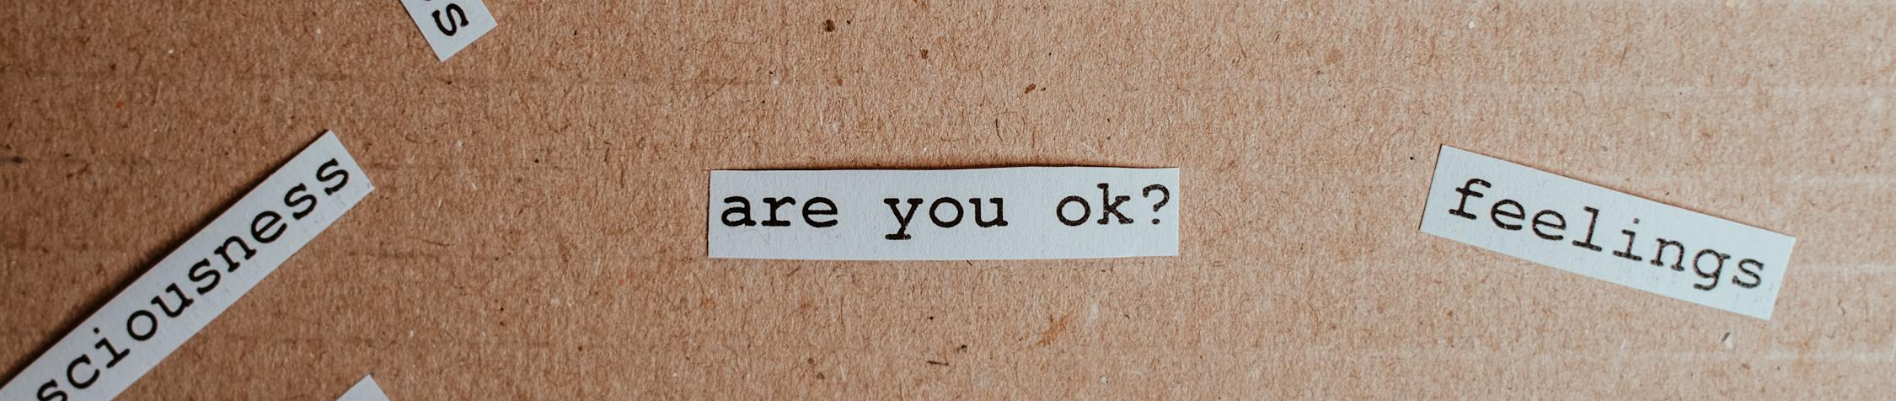
Activity OUTLINES
In the introduction of this module, you were asked as a group to practice self-awareness. In the following slides we will look at some new activities to help you encourage self-awareness and reflection skills.
Activity 1: Journaling Exercise.
Encourage learners to maintain a daily or weekly journal. They should write about their experiences, feelings, reactions to certain situations, and any self-discoveries they have made.
Activity 2: Conduct a personal SWOT analysis.
Learners conduct a personal SWOT analysis to objectively evaluate their strengths, weaknesses, opportunities, and threats. This analytical tool helps learners to understand their capabilities and areas for improvement, aiding in strategic personal development planning.
Activity 3: A Guided Meditation.
Introduce mindfulness exercises and meditation practices. These techniques help in developing a deeper awareness of one's thoughts and feelings, thereby increasing self-awareness.

Slide 16

Activity 1: Journaling Exercise.
Journaling is the practice of regularly writing down thoughts, experiences, feelings, and reflections. It serves as a tool for personal expression, self-discovery, and self-reflection. The process typically involves documenting daily events, personal insights, aspirations. Normally this would be conducted as a solo exercise, however, as an educator you might like to conduct this with students to get them started. Before you start:
Choose Your Medium.
Decide whether you prefer a traditional paper journal or a digital format. Each has its benefits; paper can feel more personal and tangible, while digital offers convenience and accessibility.
Set a Regular Schedule.
Consistency is key. Decide whether you will journal daily or weekly and stick to that schedule. Morning journaling can help set the tone for the day, while evening journaling can be a reflective practice to process the day's events.

Slide 17

Activity 1: Journaling Exercise
Step 1: Create an Optimal Environment and Structure:
Choose a quiet and comfortable space for journaling where you feel relaxed. For the group setting you can, provide prompts such as "Today, I felt...", "I am grateful for...", or "A challenge I faced today...“. This can provide structure and help initiate the writing process.
Step 2: Reflect and Identify Patterns:
Write about daily experiences and emotions, delving into your reactions and thoughts. Over time, review your entries to recognise recurring themes, patterns, stress triggers, or consistent emotional responses. This practice aids in identifying areas for personal growth and development.

Slide 18

Activity 1: Journaling Exercise
Step 3: Goal Setting and Honest Reflection:
Use your journal to set and regularly review personal and professional goals. Be honest and unfiltered in your writing, as this authenticity is key to true self-awareness. Periodically reflect on past entries to gauge your growth and changes over time.
There are no strict rules for how to journal; it can be free-form or structured, written daily or as needed. Some people prefer to write in a narrative style, recounting their day or describing their feelings, while others might use lists, bullet points, or even draw and doodle. The flexibility of journaling is what makes it accessible and beneficial for a wide range of people, regardless of their writing experience or style.

Slide 19
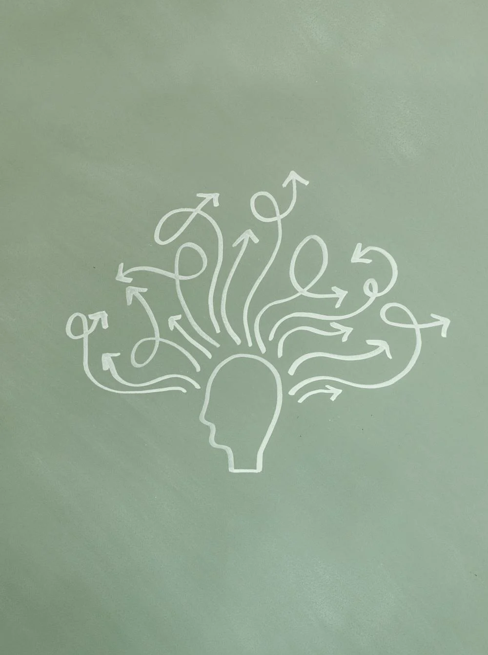
Tips For Better Journalling
Incorporate the insights gained from journaling into daily life. This could involve altering habits, improving communication styles, or refining decision-making processes. Applying these learnings ensures that journaling contributes to improvements you can see both a personal and professional setting.
Regular journaling has been linked to various health benefits, including reduced stress, improved mood, and better mental health. For entrepreneurs, who often face high levels of stress and burnout, these benefits are particularly important.
Journaling allows for reflection on personal and business goals, progress, and setbacks. This can be incredibly motivating and a valuable tool for assessing growth over time.

Slide 20
Activity 2: Personal SWOT Analysis
A personal SWOT analysis is a self-assessment tool that helps individuals identify their Strengths, Weaknesses, Opportunities, and Threats . It's a framework commonly used in business and personal development contexts to help people understand their current position and plan for future growth.
Strengths:
These are internal attributes and skills that an individual excels in. Strengths could include personal traits, experiences, knowledge, competencies, or resources that give someone an advantage.
Weaknesses:
Weaknesses are internal factors that may hinder an individual’s performance or ability to achieve goals. These could be lack of skills, negative traits, or any other personal limitations.
Opportunities:
Opportunities are external factors that an individual can exploit to their advantage. They represent potential paths for growth, development, and achievement.
Threats:
Threats are external factors that could cause trouble for the individual.

Slide 21
Activity 2: Personal SWOT Analysis
Step 1: Introduction, Explanation and reflection
Begin by explaining the concept of SWOT analysis and its relevance in personal and professional development. Ensure that everyone understands what each element of SWOT represents. Give each participant time to reflect on and write down their own strengths, weaknesses, opportunities, and threats. This should be done individually to ensure personal reflection.
Step 2: Group Sharing
Break the group into smaller sub-groups. In these smaller groups, participants share their SWOT analysis with each other. Encourage open and respectful discussions, allowing group members to provide feedback and alternative perspectives on each other's analyses. In the sub-groups, encourage participants to discuss common themes and unique insights. They can help each other identify blind spots in their self-assessments and offer suggestions for leveraging strengths and opportunities or addressing weaknesses and threats.
Step 3: Group presentation and feedback
Have each participant or sub-group present their SWOT analysis and action plan to the larger group. This encourages accountability and allows for broader feedback. As a facilitator, provide feedback and guidance throughout the process.

Slide 22
Tips To Improve Personal SWOT
After self-reflection and group feedback, participants should create a personal action plan. This plan would focus on leveraging strengths, addressing weaknesses, capitalising on opportunities, and tackling threats.
The process of self-reflection, combined with group discussions, deepens self-awareness and introduces varied perspectives, revealing new personal insights. These insights become actionable, encouraging commitment to personal development.
Incorporating peer review or mentorship after initial self-reflection can enhance the activity. Peers or mentors can offer different viewpoints, enriching the participants' understanding and aiding in the identification of areas for growth.
Educators can improve the depth of self-reflection in the SWOT analysis by guiding participants through the process with more specific questions. Instead of general prompts, encourage learners to think about specific experiences, challenges, and accomplishments. This can be achieved by asking questions like, "Can you think of a time when you successfully overcame a significant challenge?" or "What skills have you used in the past that helped you in difficult situations?"

Slide 23

Activity 3: Guided Meditation
Practicing mindfulness offers significant benefits for entrepreneurs, a group often facing high levels of stress and uncertainty. Mindfulness is about being present and fully engaged with whatever we’re doing at the moment, free from distraction or judgement.
Mindfulness helps develop a calmer state of mind, which is crucial for making sound business decisions. It enhances awareness of your thought patterns, allowing you to make decisions that align more closely with your goals and values.
It can also boost creativity, opening your mind to new ideas and perspectives, which are vital for innovation and strategy development. It improves emotional intelligence, enhancing self-awareness and empathy, which are key for effective leadership and team management.

Slide 24
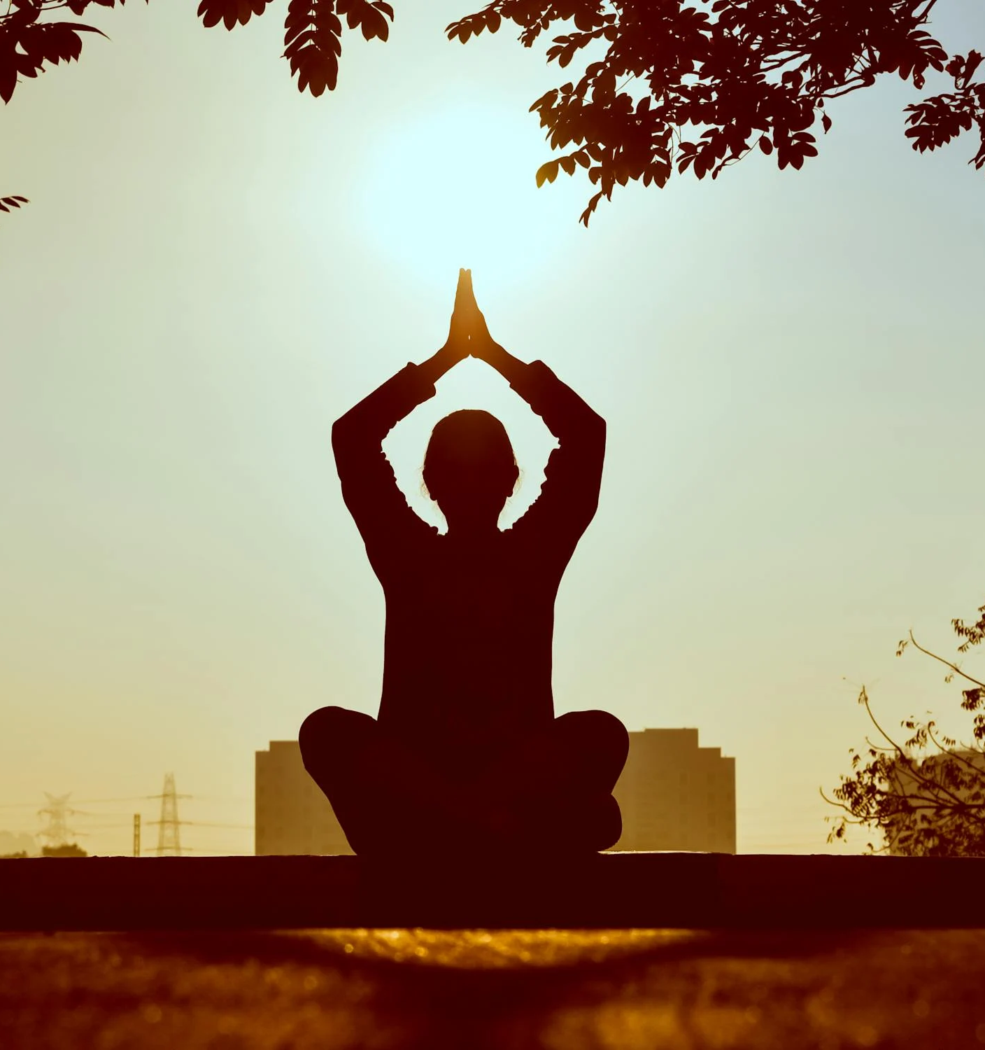
Activity 3: Guided Meditation
Although there are many forms that mindfulness and mediation can help, we will focus on how to conduct a guided meditation in the classroom to help students practice mindfulness techniques.
This meditation can be conducted for about 10-15 minutes and can be a regular part of an educational program for young entrepreneurs.
It’s designed to help participants to reduce stress, encourage a positive mindset, and enhance their focus and creativity – all essential qualities for success in entrepreneurship.

Slide 25
Activity 3: Guided Meditation
Step 1: Introduction and settling in
Begin by inviting the participants to find a comfortable seated position. Encourage them to sit in a relaxed but alert posture, either on a chair or on the floor. Ask them to close their eyes or lower their gaze to minimise distractions. Spend a few moments allowing everyone to settle in, taking deep breaths, and becoming aware of the space around them.
Step 2: Focusing on Breath
Guide the participants to focus on their breath. Instruct them to notice the sensation of air entering and leaving their nostrils or the rise and fall of their chest. This focus on breathing helps to anchor the mind in the present moment. If thoughts arise, encourage them to acknowledge these thoughts without judgment and gently return their focus to their breath.
Step 3: Body Scan for Relaxation
Slowly guide participants through a body scan, starting from the top of their head and moving down to their toes. Ask them to notice any tension in their body and consciously relax those areas. This step is crucial for releasing physical stress and establishing a mind-body connection.

Slide 26
Activity 3: Guided Meditation
Step 4: Visualisation for Entrepreneurial Mindset:
Invite the participants to visualise themselves in their entrepreneurial journey. Encourage them to imagine overcoming challenges, achieving goals, and feeling confident and capable.
This visualisation technique can help build resilience, focus, and a positive mindset towards their business goals.
Step 5: Reflection and Gratitude:
Towards the end of the meditation, guide them to think about what they are grateful for in their personal, academic or professional life. Gratitude can shift focus from challenges to positive aspects, enhancing overall well-being.
Step 6: Closing the Session:
Gradually guide them back to the awareness of the room. Ask them to notice the sounds around them, the chair or floor beneath them, and slowly open their eyes.
Conclude the session with a few deep breaths and encourage a moment of silent reflection on the experience.

Slide 27

Tips To Improve Guided Meditation
You can change the meditation in the follow ways:
Start the meditation with a few minutes of structured breathing exercises, such as deep belly breathing or alternate nostril breathing. This can help participants to relax and prepare for the meditation.
Include reflective questions or prompts towards the end of the meditation. Provide reflective questions or prompts that participants can think about or journal on later. This can deepen the reflective aspect of the practice.
Change the length of the meditation sessions. Some days you might do a shorter, 5-minute meditation, while other times you might extend it to 20-30 minutes, depending on the group's experience and preferences.

Slide 28

04
Reflection and Conclusion

Slide 29

REFLECTION
Throughout this module we learned a lot of different ways of how we can become more self-aware and how to reflect.
Take a look a the questions from the first slide, we will add them to the next slide to remind you!
Spend 5 minutes to try and answer these now with the information you now have.
Compare your answers from before, what did you learn?

Slide 30
WARM-UP EXERCISE (REFLECTION)
These were the questions from the warm up exercise:
As a group, think and make notes about the following things:
What do you think reflection is?
What do you think self awareness is?
Do you think you are self aware already? Give some examples of where you are self aware, or could have been more self awareness.
Do you think being self aware is important as an entrepreneur?
Notes:
Please use this „notes“ section to provide additional advice for the teacher.

Slide 31

REFLECTION
Also, reflect as a group on the following questions:
What was your favourite activity?
What was your least favourite activity?
Do you think you will practice any of these exercises after this session?
Do you think that you are more self-aware after this session?

Slide 32

FOLLOW OUR JOURNEY
www.entrepreneurshiplabs.eu

