Slide 1
BUILDING SELF-CONFIDENCE
The Journey to Believing in Yourself
Funded by the European Union. Views and opinions expressed are however those of the author(s) only and do not necessarily reflect those of the European Union or the European Education and Culture Executive Agency (EACEA). Neither the European Union nor EACEA can be held responsible for them.
Co-funded by the Erasmus+ Programme of the European Union

Slide 2
Believe in yourself and all that you are. Know that there is something inside you that is greater than any obstacle.
n t r e p r e n e u r s h i p L a b s
Christian D. Larson
E
E x p e r i e n t i a l
This resource is licensed under CCBY 4.0

Slide 3
Warm-Up Exercise: "The Confidence Circle"
Form a circle with everyone facing towards the center.
You’ll be given a prompt: "Share something you're
good at and why you feel confident about it."
Take turns to share with the rest of us. Just a sentence or two is perfect!
Once we've all shared, we’ll reflect on how it feels to speak about our strengths and listen to others.
Why We're Doing This:
To build a comfortable and supportive environment for our upcoming discussions.
E x p e r i e n t i a l E n t r e p r e n e u r s h i p L a b s

Slide 4
TABLE OF CONTENTS
01
02
03
04
Introduction and Motivation Concept and Basics
Practical Skills Development Reflection and Conclusion
E x p e r i e n t i a l E n t r e p r e n e u r s h i p L a b s

Slide 5
01
INTRODUCTION AND MOTIVATION
E x p e r i e n t i a l E n t r e p r e n e u r s h i p L a b s

Slide 6
Welcome to Your Self-Confidence Journey!
Engagement Question: What does self-confidence mean to you? How does it impact your daily activities?
Confidence triggers a positive loop in our brain, enhancing our ability to think creatively and solve problems.
The brain's chemistry changes in response to confidence, releasing neurotransmitters that enhance focus and decision-making.
Confident individuals are more likely to take calculated risks and seize opportunities effectively.
Inspiring Quote: "With realization of one’s own potential and self- confidence in one’s ability, one can build a better world." – Dalai Lama
E x p e r i e n t i a l E n t r e p r e n e u r s h i p L a b s

Slide 7
The Importance of Self-Confidence
Key Insight: Discover why self-confidence is essential in various aspects of life – from personal growth to career success.
Overcoming challenges is linked to increased resilience, a key component of self-confidence.
Each challenge overcome serves as a 'proof point',
reinforcing our belief in our abilities.
People who face challenges head-on tend to develop
better coping strategies over time.
Reflection: Think about a time when confidence made a difference in your life.
E x p e r i e n t i a l E n t r e p r e n e u r s h i p L a b s

Slide 8
Myths About Self-Confidence
Interactive Task: List common myths you’ve heard about self-confidence. Let’s bust these myths together!
One common myth is that self-confidence means you're confident in every aspect of life. In reality, it's normal to feel more confident in some areas than in others.
Another myth is that self-confidence is something you're born with. However, confidence can be developed and strengthened over time through experiences and learning.
There's a misconception that confident people never experience doubt. The truth is, even the most confident individuals have moments of uncertainty; what sets them apart is how they manage and respond to these doubts.
Discussion: Share your thoughts with a partner. Why are these beliefs misleading?
E x p e r i e n t i a l E n t r e p r e n e u r s h i p L a b s

Slide 9
02
E x p e r i e n t i a l E n t r e p r e n e u r s h i p L a b s
CONCEPT AND BASICS

Slide 10
What Is Self-Confidence?
Definition: Understand self-confidence as trusting in
your abilities and judgments.
Recognize that personal strengths go beyond talents; they include your skills, knowledge, and experiences that make you unique.
Reflect on moments when you felt successful or received praise—these can offer clues to your inherent strengths.
Personal strengths can be related to character as well—traits like resilience,
empathy, and determination are powerful aspects of who you are.
Activity: Write down three personal strengths that boost your confidence.
E x p e r i e n t i a l E n t r e p r e n e u r s h i p L a b s

Slide 11
Self-Confidence vs. Self-Esteem
Comparison: Learn the difference between self-confidence (belief in your abilities) and self-esteem (overall value you place on yourself).
Self-confidence is about trusting your ability to handle specific tasks and challenges, while self-esteem relates to how you perceive and value yourself overall.
Self-esteem is generally stable over time, but self-confidence can fluctuate based on experiences, feedback, and internal thought processes.
High self-esteem doesn't necessarily mean high self-confidence; you can value yourself highly but still doubt your abilities in certain areas.
Self-Reflection: Reflect on which area you feel more assured in and why.
E x p e r i e n t i a l E n t r e p r e n e u r s h i p L a b s

Slide 12
The Science of Self-Confidence
Insight: Explore how our brain reacts to confidence and its impact on our decision-
making.
Confidence triggers a positive loop in our brain, enhancing our ability to think creatively and solve problems.
The brain's chemistry changes in response to confidence, releasing neurotransmitters that enhance focus and decision-making.
Confident individuals are more likely to take calculated risks and seize opportunities
effectively.
Quick Quiz: Take a short quiz to test your understanding of the science behind confidence.
E x p e r i e n t i a l E n t r e p r e n e u r s h i p L a b s

Slide 13
Quiz: The Science Behind Confidence
Instructions: Choose the best answer for each question to test your knowledge of
how confidence works in our minds and bodies.
Question 1: What part of the brain is associated with regulating emotions and plays a role in feeling confident?
Cerebellum
Amygdala
Hippocampus
Frontal lobe
Question 2: True or False: Confidence can alter the levels of chemicals in your brain, like serotonin and dopamine.
True
False
E x p e r i e n t i a l E n t r e p r e n e u r s h i p L a b s

Slide 14
Quiz: The Science Behind Confidence
Question 3: Which neurotransmitter is known as the 'confidence chemical' because it helps to regulate mood
and promote feelings of positivity and self-esteem?
Adrenaline
Dopamine
Oxytocin
Serotonin
Question 4: Confidence has been shown to improve performance. Which of the following can it specifically enhance?
Memory recall
Problem-solving abilities
Physical endurance
All of the above
E x p e r i e n t i a l E n t r e p r e n e u r s h i p L a b s

Slide 15
Quiz: The Science Behind Confidence
Question 5: True or False: Our body language can affect our brain chemistry, influencing our confidence levels.
True
False
Question 6: 'Power posing' before a stressful event is said to boost confidence. What does this practice directly influence?
Muscle strength
Hormone levels
Intelligence
Flexibility
E x p e r i e n t i a l E n t r e p r e n e u r s h i p L a b s

Slide 16
Quiz: The Science Behind Confidence
Question 7: How does repeatedly practicing positive self-talk potentially change our brain?
It increases the size of the brain.
It creates new neural pathways associated with positive thinking.
It reduces the number of neurons.
It changes the color of the brain matter.
Question 8: Which hormone, associated with stress, can be lowered by engaging in confidence-boosting activities?
Insulin
Cortisol
Estrogen
Testosterone
E x p e r i e n t i a l E n t r e p r e n e u r s h i p L a b s

Slide 17
Quiz: The Science Behind Confidence
Question 9: True or False: Only people with naturally high levels of confidence can improve their confidence
through practice.
True
False
Question 10: Studies have shown that visualizing successful outcomes can improve actual performance. This phenomenon is known as:
The placebo effect
The confidence-competence loop
Mental rehearsal
The success syndrome
E x p e r i e n t i a l E n t r e p r e n e u r s h i p L a b s

Slide 18
03
Practical Skills Development
E x p e r i e n t i a l E n t r e p r e n e u r s h i p L a b s

Slide 19
Building Confidence Through Challenges
Learning Point: Understand how overcoming challenges can enhance your
self-confidence.
Overcoming challenges is linked to increased resilience, a key component of self-confidence.
Each challenge overcome serves as a 'proof point', reinforcing our belief in our abilities.
People who face challenges head-on tend to develop better coping strategies over time.
Challenge Activity: Identify a personal challenge you want to overcome. Share if you want with a group.
E x p e r i e n t i a l E n t r e p r e n e u r s h i p L a b s

Slide 20
The Power of Positive Self-Talk
Skill Development: Learn how to transform negative thoughts into positive affirmations.
Positive self-talk can significantly reduce stress and anxiety, leading to improved performance in various tasks.
Athletes often use positive self-talk as a technique to enhance their performance under pressure.
Practice Exercise: Convert one negative belief about yourself into a positive, empowering statement.
E x p e r i e n t i a l E n t r e p r e n e u r s h i p L a b s

Slide 21
Effective Goal Setting
Skill Enhancement: Learn how setting achievable goals can boost your confidence.
Setting and achieving small, realistic goals can create a sense of accomplishment, which in turn boosts confidence in one’s abilities.
The process of goal-setting helps clarify thoughts, which can reduce anxiety and increase self- confidence as it provides a clear path forward.
Achievable goals act as milestones; each time you reach one, it reinforces the belief in your capabilities and encourages you to tackle bigger challenges.
Goal-Setting Activity: Write down a short-term goal and the steps you plan to take to achieve it.
E x p e r i e n t i a l E n t r e p r e n e u r s h i p L a b s

Slide 22
Role Models and Mentors
Inspiration Source: Understand how role models and mentors can influence your self-confidence.
Having a role model or mentor can significantly influence one’s approach to
challenges and personal development.
Role models, whether known personally or admired from afar, provide real-life examples of confidence in action.
Mentors offer guidance, feedback, and support, which are crucial for developing
self-confidence, especially in new or challenging areas.
Observing how role models and mentors handle success and failure can provide
valuable lessons in resilience and confidence.
Research Task: Identify a role model or mentor. Research their journey and how they built confidence.
E x p e r i e n t i a l E n t r e p r e n e u r s h i p L a b s

Slide 23
Communication Skills for Confidence
Skill Focus: Explore how effective communication is key to self-confidence.
Effective communicators are often perceived as more confident, competent, and trustworthy.
Non-verbal cues, such as posture and eye contact, play a crucial role in confident
communication.
Active listening, an aspect of communication, is linked to building stronger, more empathetic relationships.
Practice Scenario: Role play with good and bad examples of non-verbal communication and its effects
E x p e r i e n t i a l E n t r e p r e n e u r s h i p L a b s

Slide 24
Overcoming the Fear of Failure
Resilience Building: Learn how to view failures as learning opportunities.
Viewing failure as a stepping stone rather than a setback is a common trait among successful individuals.
Fear of failure can be reduced by setting realistic expectations and preparing adequately for tasks.
Learning from failures helps build resilience, an essential quality for long-term
success and confidence.
Reflection: Write about a time you learned something valuable from a failure.
E x p e r i e n t i a l E n t r e p r e n e u r s h i p L a b s

Slide 25
04
REFLECTION AND CONCLUSION
E x p e r i e n t i a l E n t r e p r e n e u r s h i p L a b s

Slide 26
Reflecting on Your Confidence Journey
Recap: Review what you've learned about building self-confidence.
Personal Reflection: Write a short paragraph on how you plan to apply these lessons in your life.
E x p e r i e n t i a l E n t r e p r e n e u r s h i p L a b s

Slide 27
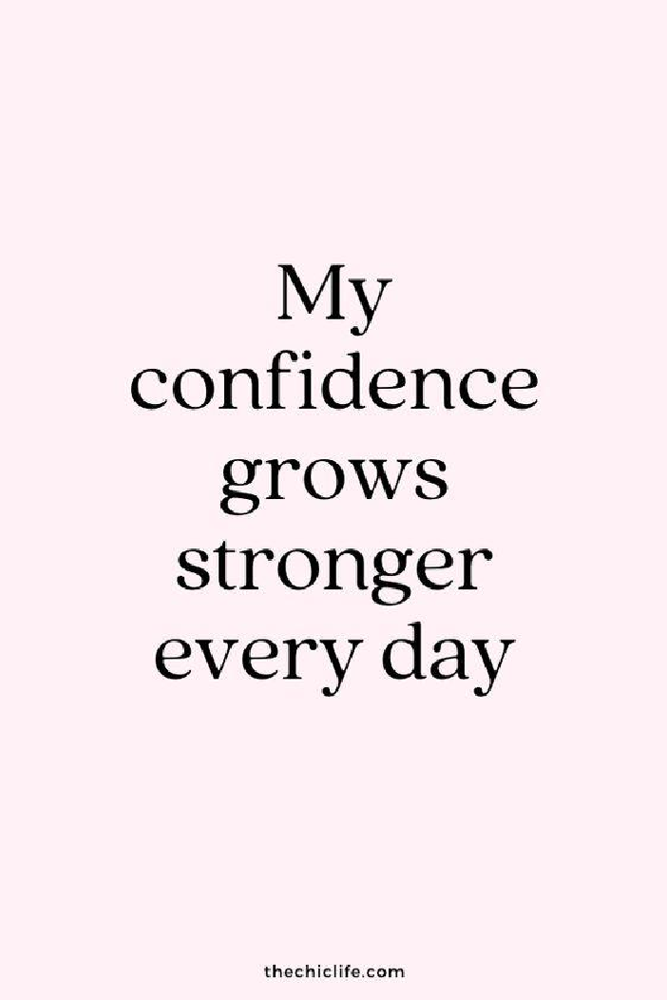
The Continuous Path of Growth
Future Focus: Understand that building self-confidence is an ongoing journey.
Growth Plan: Outline one area where you want to continue growing your confidence.
E x p e r i e n t i a l E n t r e p r e n e u r s h i p L a b s

Slide 28
Creative Expression of Confidence
Creative Task: Express your journey or understanding of self-confidence through art, writing, or another creative form.
Showcase: Share your creation with the class and explain what it represents about your confidence journey.
E x p e r i e n t i a l E n t r e p r e n e u r s h i p L a b s

Slide 29
Your Feedback Matters
Module Evaluation: Provide feedback on this self-confidence module. What was most impactful for you?
Closing Thoughts: Share your closing thoughts on the module with the class.
E x p e r i e n t i a l E n t r e p r e n e u r s h i p L a b s

Slide 30
FOLLOW OUR JOURNEY
www.entrepreneurshiplabs.eu
Co-funded by the Erasmus+ Programme of the European Union
Funded by the European Union. Views and opinions expressed are however those of the author(s) only and do not necessarily reflect those of the European Union
or the European Education and Culture Executive Agency (EACEA). Neither the European Union nor EACEA can be held responsible for them.

